Slide 1
SER 334 A Session
SI Session
Monday, January 22nd 2024
7:00 pm - 8:00 pm MST

Slide 2
{
Agenda
Run-Time Execution
Review Memory
OS Structures
Module Samples

Slide 3
SI Session Expectations
Thanks for coming to the SER 334 SI session. We have a packed agenda and we are going to try to get through as many of our planned example problems as possible. This session will be recorded and shared with others.
If after this you want to see additional examples, please visit the drop-in tutoring center.
We will post the link in the chat now and at the end of the session.
tutoring.asu.edu
Please keep in mind we are recording this session and it will be made available for you to review 24-48 hours after this session concludes.
Finally, please be respectful to each other during the session.

Slide 4

Interact with us:
Zoom Features
Zoom Chat
Use the chat feature to interact with the presenter and respond to presenter’s questions.
Annotations are encouraged

Slide 5
SER 334
What is a system call?
System Calls
A call that needs a high level of privilege
Examples:
Notes:
Process control - forks, locks, concurrency, job control, etc
File management - read file, write file
Device management -
Info maintenance - system health, running processes
Communications
Protection

Slide 6
SER 334
What is a system call?
System Calls
A call that needs a high level of privilege
Main Categories:
Resource
Allocation
Interacting with
Low-Level Hardware
Potentially Dangerous Actions
Notes:
Device access, mem allocation
Getting system time, processor status - need the call for that specific type, version, firmware, etc
Stopping another program, manipulating another program

Slide 7
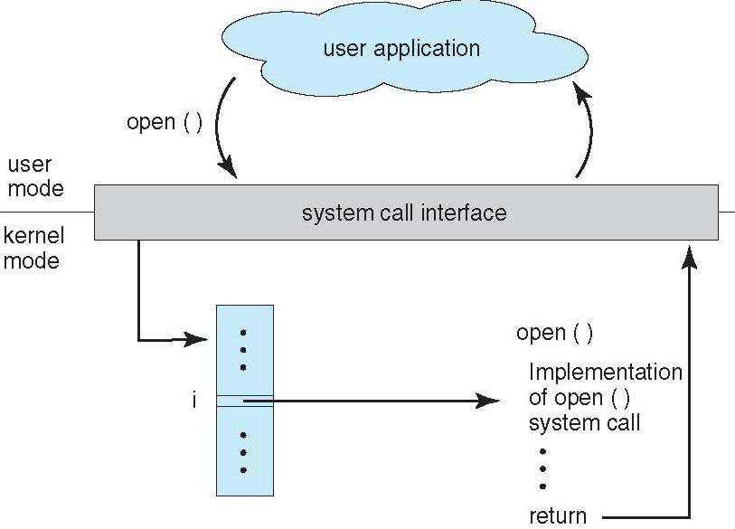
What are the steps for run-time execution?
SER 334
Run-Time Execution
result
Make Call
open()
SCI
result
Go To: System Call Interface
SCI looks up call in Table
Find Implementation
Run that implementation
Obtain result and send to SCI
result
Return result to user

Slide 8
Why is the SCI important?
SER 334
Run-Time Execution
Make Call
SCI
Go To: System Call Interface
SCI looks up call in Table
Find Implementation
Run that implementation
Obtain result and send to SCI
Return result to user
Abstraction - SCI will choose the correct implementation based on the hardware and the OS

Slide 9
Contents:
Memory
SER 334
Stack
Memory
Text/Code
Heap
Global & Static Variables/Objects
Static Memory
Dynamic Memory
Stack Pointer
Heap Pointer

Slide 10
Contents:
Memory
SER 334
Stack
Text/Code
Memory
Text/Code
Static Memory
Global & Static Variables/Objects
Heap
Global & Static Variables/Objects
Heap Pointer
Heap
Static Memory
Dynamic Memory
Dynamic Memory
Stack Pointer
Stack
Stack Pointer
Heap Pointer

Slide 11
SER 334
Structure Types
Do we remember the 4 structure types?
Organic/Simple
Layered
Modules
Microkernel

Slide 12
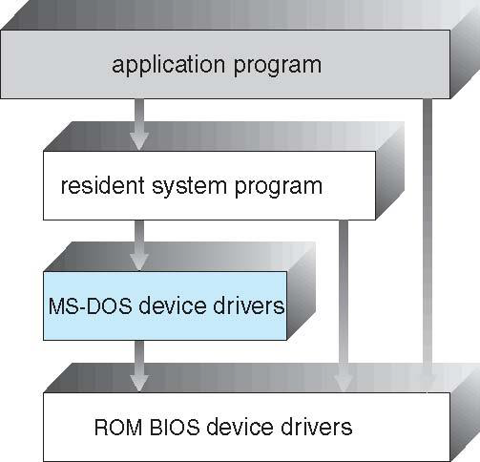
Organic/Simple
Goal: Just make it work!
SER 334
Structure Types
👍
Pros:
👎
Cons:
Fast Design
Fast Implementation
Hard to maintain
Unsafe
Error-prone
Notes:
Hard to maintain bc everything is just thrown together
Unsafe and error prone bc we are giving everything full access

Slide 13
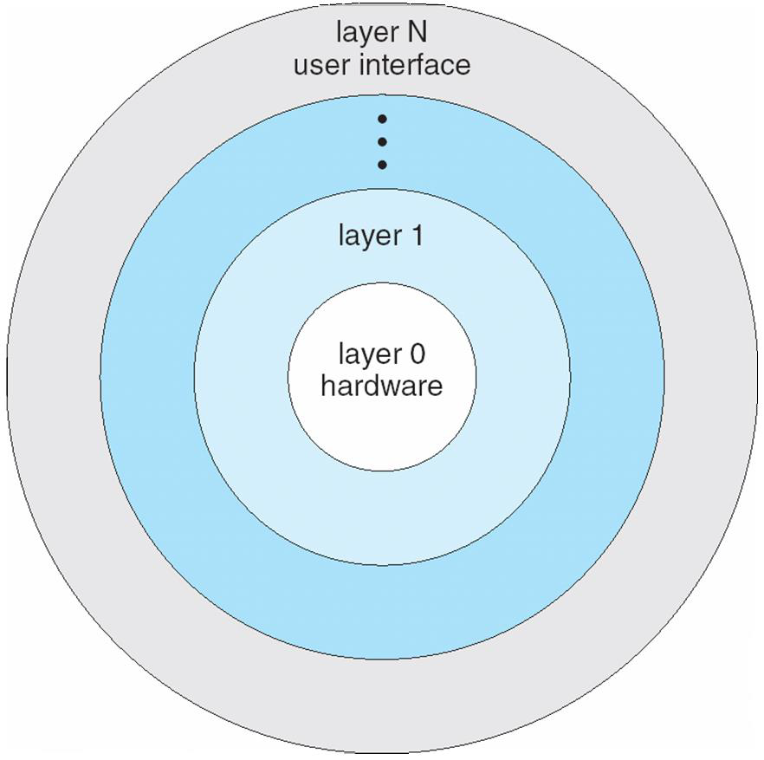
Goal: Explicit layers only have access to calls at their level or below
Layered
SER 334
Structure Types
👍
Pros:
👎
Cons:
Reliable
Easy to maintain
Portable
SLOW Design
SLOW speed

Slide 14
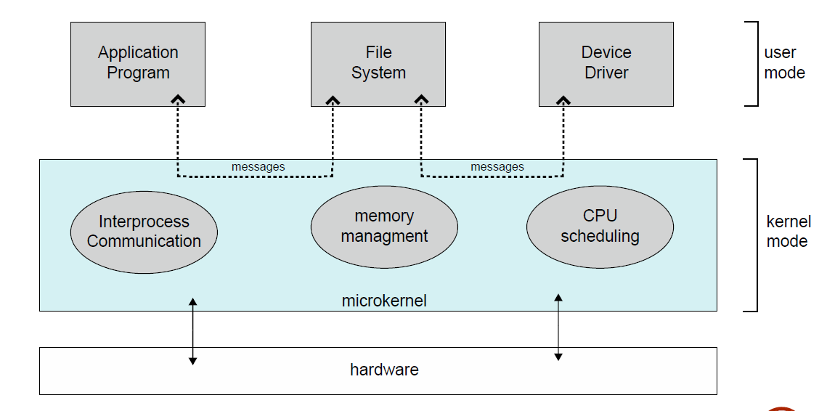
Microkernels
Goal: Create the smallest base kernel possible
SER 334
Structure Types
👍
Pros:
👎
Cons:
Kernel is small
Fast
Reliable
Maintainable
Design Time
Base Kernel only cares about:
Message Passing
Resource Allocation
Plugins
Notes:
Small kernel = more performance, and more maintainable
Design time = which plugins should i support? Delegating responsibilities

Slide 15
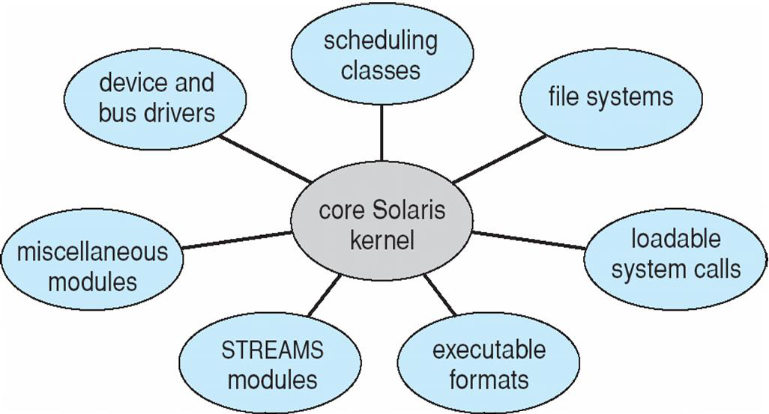
Modules
Goal: Support dynamic loading of modules
SER 334
Structure Types
👍
Pros:
👎
Cons:
Kernel is small
Fastest
Reliable
Maintainable
Unsafe
What’s the difference between Modules and Microkernels?
Everyone can talk to everyone

Slide 16
Unit 1, Question 2
SER 334
Sample Review
2. [Acuña] Consider the following program. It compiles without any compile-time errors in GCC, yet it contains a total of 4 issues (a combination of syntax, and logical problems). Study the program to identify all the issues. For each issue, list its type (syntactic, logical), what the problem is, and how to fix it.
1 #include <stdio.h>
2 int main() {
3 int input;
4 int result;
5 printf("Enter an integer number:\n");
6 scanf("d", input);
7
8 result = input % 2;
9
10 if (result = 0)
11 printf("\nNumber %d is even.", input);
12 else
13 printf("\nNumber %d is odd.", input);
14 }
Line:
Type:
Line:
Type:
Line:
Type:
Line:
Type:

Slide 17
Unit 1, Question 4
SER 334
Sample Review
4. [Karaliova] Consider the following declarations in C and Java. Answer the following for each declaration: 1) What data type is declared? 2) What value would we get if we attempt to access myExample[6]? 3) What value would we get if we attempt to access myExample[7]? [3 points]
a) C:
char myExample[] = {'s', 'e', 'r', '3','3','4'};
b) C:
char myExample[] = "ser334";
c)Java:
char[] myExample = {'s', 'e', 'r', '3','3','4'};
Data Type:
myExample[6]:
myExample[7]:
Data Type:
myExample[6]:
myExample[7]:
Data Type:
myExample[6]:
myExample[7]:

Slide 18
1 int a, *b, **c, d;
2 a = 5;
3 d = a + 1;
4 b = &a;
5 c = &b
6 // Point 1
7 *b = 8;
8 b = &d;
9 **c = 3;
10 // Point 2
11 b+=7;
12 // Point 3
Unit 1, Question 8
SER 334
Sample Review
Type | int | int (deref) | int pointer | int pointer (deref) | int double pointer | int
Var Name | a | *b | b | *c | c | d
Point 1
Point 2
Point 3

Slide 19
Unit 2, Question 3
SER 334
Sample Review
3. [Acuña] Consider the problem of padding the following structure, and answer the three questions below.
Assume that you are compiling on a system with a 32-bit architecture. [4 points total]
struct bmp_header {
char creator_name[254];
int width;
int height;
char signature_rgb[2];
int offset_pixels;
};
(a) What is the size of this struct as defined?
(b) How much space would be wasted with word length padding?
(c) [Katie] Redefine the structure to reduce the wasted space.

Slide 20
Unit 2, Question 6
SER 334
Sample Review
6. [Acuña] Consider the following function which adds a new node to the front of a list passed as a parameter called param_list.
struct grade_node {
int value;
char assignment[255];
struct grade_node* next;
};
void add_node(grade_node* param_list, grade_node* node) {
if(node != NULL) {
node->next = param_list;
param_list = node;
}
}
Is it possible for this function ever to work incorrectly? If so, under what conditions does it fail?

Slide 21
Unit 3, Question 4
SER 334
Sample Review
4. [Acuña] Consider the following file storage scenarios:
(a) A word processing file that stores text, formatting information, tables, and images.
(b) A configuration file that is meant to be edited by advance users.
(c) An executable program file that displays a class schedule.
Which of these should be implemented using a plain text file or a binary file format? Explain.
Data Type:
Reason:
Data Type:
Reason:
Data Type:
Reason:

Slide 22
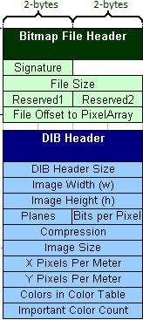
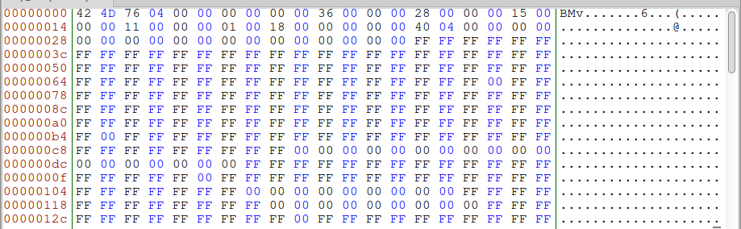
Unit 3, Question 4
SER 334
Sample Review
5. [Acuña] Shown below is a valid BMP file that has been opened in a hex editor. Based on the data visible, answer the following questions. Indicate which number base you use for each question. (The complete specification is shown in the appendix.) Note that this screen shot comes from an Intel architecture system where numbers are stored with little-endian byte ordering
(a) How large is the file?
(b) What is the width and height of this image?
(c) How many bits per pixel are used?
(d) Using b and c, how many bytes are required for each row? How many are for padding?
a)
b)
c)
d)

Slide 23
Unit 4, Question 3
SER 334
Sample Review
3. [Karaliova] For most programming languages, the run-time support library provides a system call interface that translates function calls into corresponding system calls. Why do we need an intermediate between the two instead of invoking system calls from a program directly? Explain.
Notes:
Abstraction
Security - access privileges
maintainability/portability - will select the best/newest implementation

Slide 24
Unit 4, Question 7
SER 334
Sample Review
7. [Lisonbee] Compare and contrast the organic and microkernel operating system structures. Explain how the efficiency (speed), security, and maintainability of each compare, and why.
Notes:
Organic
Faster (direct access)
Less secure - direct access to low level
Harder to maintain - all in one bucket
Microkernel
Slower - must travel through intermediary
More secure - plugin comm must go through microkernel first
Easier to maintain - plugins give separation of concerns

Slide 25
Upcoming Events
SI Sessions:
Sunday, January 28th at 7:00 pm MST Cancelled - good luck on Exam 1!
Monday, January 29th at 7:00 pm MST
Thursday, February 1st at 7:00 pm MST
Review Sessions:
Exam 1 Review: Thursday, January 25th 7:00 pm - 9:00 pm MST

Slide 26

Questions?
Survey:
http://bit.ly/ASN2324

Slide 27


More Questions?
Check out our other resources!
tutoring.asu.edu
1-
2-
Click on ‘Go to Zoom’ to log onto our Online Tutoring Center.
Click on ‘View the tutoring schedule’ to see when tutors are available for specific courses.

Slide 28
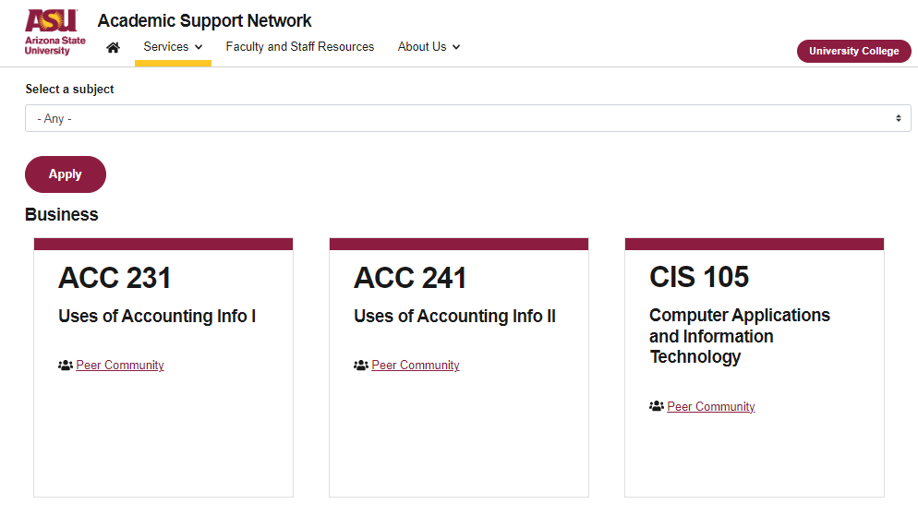

More Questions?
Check out our other resources!
tutoring.asu.edu/online-study-hub
Don’t forget to check out the Online Study Hub for additional resources!

Slide 29
Additional Resources
Course Repo
Course Discord
BMP File Format (Wiki)
Linux Kernel API

